Slide 1
SYSTEM virtualisation and Security
CMM530 – Systems Programming and Security

Slide 2
Overview
Fundamentals of Virtualisation
Virtualization Security
Vulnerabilities
Defending Virtualized Systems
Principles
Solutions and Appliances
CMM530 – Systems Programming and Security

Slide 3
Fundamentals of Virtualisation

Slide 4
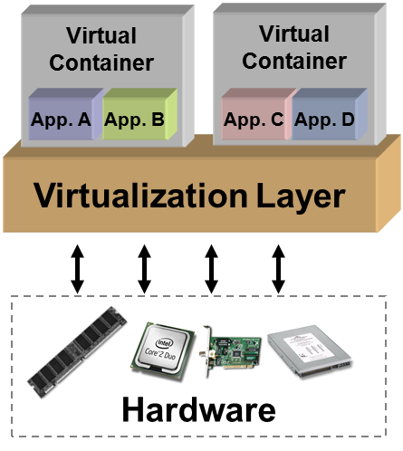
Virtualisation Recap
Creation of a layer that maps the interface of a system (virtual machine) or component (i.e., I/O device) onto the interface and resources of an underlying (possibly different) real system.
Purposes:
Abstraction
Replication
Isolation
Cross compatibility/Encapsulation
Does not necessarily aim to simplify or hide details.
Managed by a virtual machine monitor (VMM).
© 2008 Crossbeam Systems
Source: Mario Diaz– Virginia Tech University, 2009

Slide 5
Virtual machine implementations

Slide 6
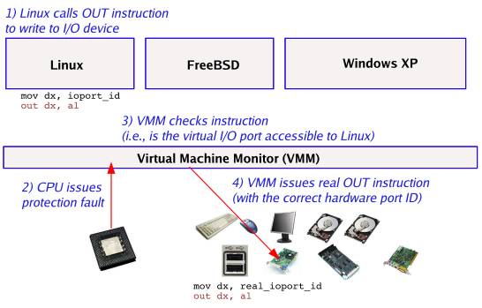
VMM Trap Example
© Matt Welsh – Harvard University, 2006

Slide 7
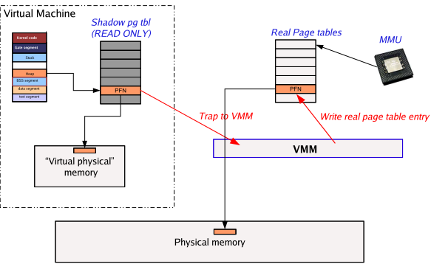
Virtualisation of Memory
A VM modifies “shadow” page tables (not the real ones)
The VMM has to trap access to them and then update the real page tables accordingly.
© Matt Welsh – Harvard University, 2006

Slide 8
Virtualisation security

Slide 9
Virtualisation Vulnerabilities
© 2009 Crossbeam Systems
Gaining access between the Guest and the Host OS?
Capturing data between VMs – Man in the Middle Attacks?
Guest OS
Guest OS
Guest OS
Hypervisor
How robust is the hypervisor?
Vulnerabilities in the underlying OS?
Host OS

Slide 10
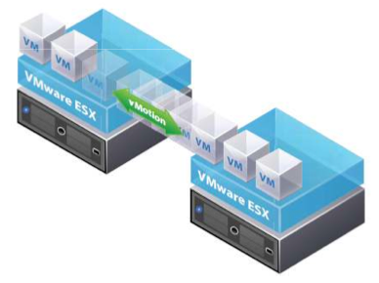
Virtual Machine Migration
Transfer from one physical server to another, with little or no downtime
For load balancing and high availability
If transfer is unencrypted, man-in-the-middle attack is possible, allowing changes to the VM enroute.
© VMWare Vmotion brochure

Slide 11
Virtualisation Security Issues
Hypervisor is the underlying component of all these architectures. It is a new layer which needs to be protected
Scale of deployments – the sheer scale of deployments make this a security challenge
e.g. Imagine 150 virtual machines running a simultaneous scheduled AV scan on the same physical host.
Isolation - Machines of a company and its competitor could be running on the same physical machine. Insufficient isolation could lead to disaster
Guess OS monitoring by the hypervisor, which has privileged access rights
New API’s to access Virtualization services - bugs in these could lead to compromise of entire infrastructure.
Source: Huzur Saran– IIT Delhi, 2009

Slide 12
Security Concepts in Architecture
Extended computing stack
New privileged layers (Hypervisor) exist underneath the OS that need to be considered
Guest isolation
One guest VM cannot be allowed to access or even address the “hardware resources” of another guest VM or the host/hypervisor
Host Visibility from the Guest
Can the guest OS detect that it is virtualized and if so can it see anything on the host?
Virtualized interfaces
Physical connectivity between guests is recreated, e.g. IP network, file shares, may be more or less like true physical counterparts
Management interfaces
The protection of management interfaces (Console OS, VirtualCenter, etc…) very important.
Root or Administrator Access to these interfaces provides “keys to the kingdom”
Greater co-location of data and assets on one box
Concept of mixing of Trust/Security Zones on a single physical box

Slide 13
Operational Security Issues
Most security issues arise not from the virtualization infrastructure itself but from operational issues
Adapting existing security processes and solutions to work in the virtualized environment
Most security solutions do not care whether a machine is physical or virtual
The risk of misconfiguration requires use of best practices specific to virtualization

Slide 14
Defending Virtualized systems

Slide 15
Virtualisation Security Principles
Open design: you need all the help you can get
Economy of mechanism: fewer things to get right
Minimize secrets: secrets do not remain secret
Fail-safe defaults: most users won’t change them
Least privilege: limit the damage of an accident
Separation of privilege: dangerous operation should require multiple principals
Complete mediation: check every operation
Source: Huzur Saran– IIT Delhi, 2009

Slide 16
Hypervisor Security
Hypervisors are written by humans. They have bugs – typically buffer overflows
Hypervisor are complex – Xen is about 300K source lines of code
Should be installed in isolated environment and updated to the latest path level – the same approaches as to OS security
Complete isolation is hard – Most systems do not have IOMMU’s which make it possible to DMA to arbitrary physical memory
Access to hypervisor should be limited to authorised administrators only.
Source: Huzur Saran– IIT Delhi, 2009

Slide 17
Memory and Input/Output Security
DMA is a big problem on non IOMMU based systems:
Xen can setup DMA
Dom0 can setup DMA
Driver domains can setup DMA
The range of physical addresses is not verified
IOMMU based systems can restrict the range of addresses but they are not present in commodity hardware
There are some techniques to even bypass IOMMU checks
Source: Huzur Saran– IIT Delhi, 2009

Slide 18
Virtualisation Security Solutions
Trusted hypervisor
Hyperguard (Phoenix Technologies) - A hypervisor integrity scanner.
Deepwatch (Intel project) – Virtualisation rootkit scanner
Domain0 Hardening – Various security solutions
Source: Huzur Saran– IIT Delhi, 2009

Slide 19
Virtualisation Security Opportunities
New breed of security products is now possible to protect guest OS’s from being hijacked
Hypervisor-based security suites cannot be detected by malware running in the guest
Hypervisors allow introspection of very early boot sequences of the guest, thereby making possible an entire new breed of BIOS rootkit and kernel rootkit scanners
API’s like VMSafe from VMWare allow introspection of interesting system events in the guest OSes
These events can then be processed on a dedicated security appliance
These events include CPU state monitoring, page faults, memory/register accesses, File-system events, network events etc.
Source: Huzur Saran– IIT Delhi, 2009

Slide 20
Dedicated Security Appliances
AV
F
W
AV
F
W
AV
F
W
AV
F
W
AV
F
W
AV
F
W
OS
OS
OS
OS
OS
OS
Enterprise Hypervisor
Hardware
Security Appliance Manager
Antivirus
Firewall
OS
OS
OS
OS
OS
OS
Enterprise Hypervisor
AV Shim
FW Shim
Hardware
Source: Huzur Saran– IIT Delhi, 2009

Slide 21
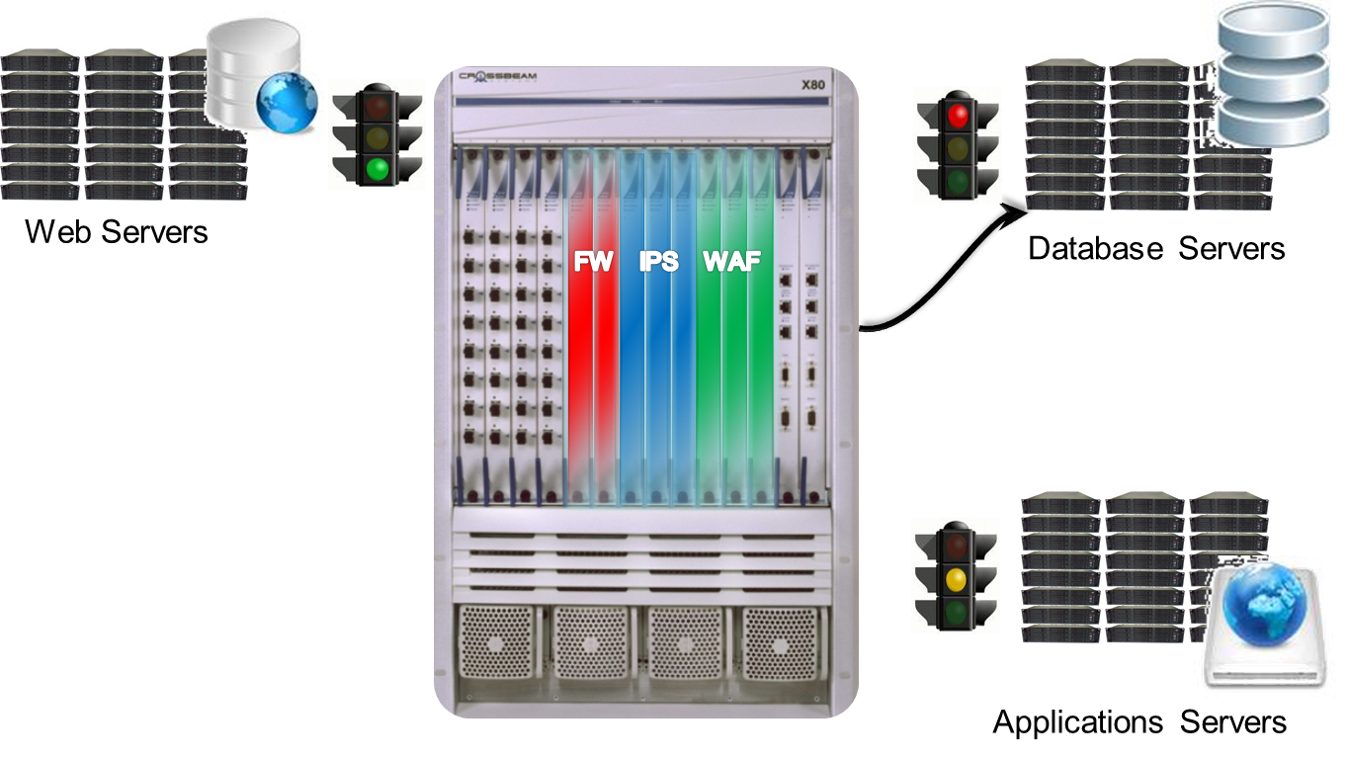

Security Appliance Solution
© 2009 Crossbeam Systems
Centrally manage, enforce and change whenever you need
CMM530 – Systems Programming and Security

Slide 22
Security Advantages of Virtualisation
Better Forensics and Faster Recovery After an Attack
A compromised machine can be cloned in it current compromised state for forensic analysis
Once cloned the VM can be immediately restored to a known good snapshot which is much faster than a physical server, reducing the impact of a security-related event
Patching is Safer and More Effective
You can quickly revert to a previous state if a patch is unsuccessful, making you more likely to install security patches sooner
You can create a clone of a production server easily, making you more likely to test security patches and more likely to install security patches
VMware Update Manager does patch scanning and compliance reporting, along with patch remediation for both online and offline VMs
More Cost Effective Security Devices
You can put in place cost effective intrusion detection, vulnerability scanning, and other security related appliances
Future: Leveraging Virtualization to Provide Better Security
Better Context – Provide protection from outside the OS, from a trusted context
New Capabilities – view all interactions and contexts

